Slide 1
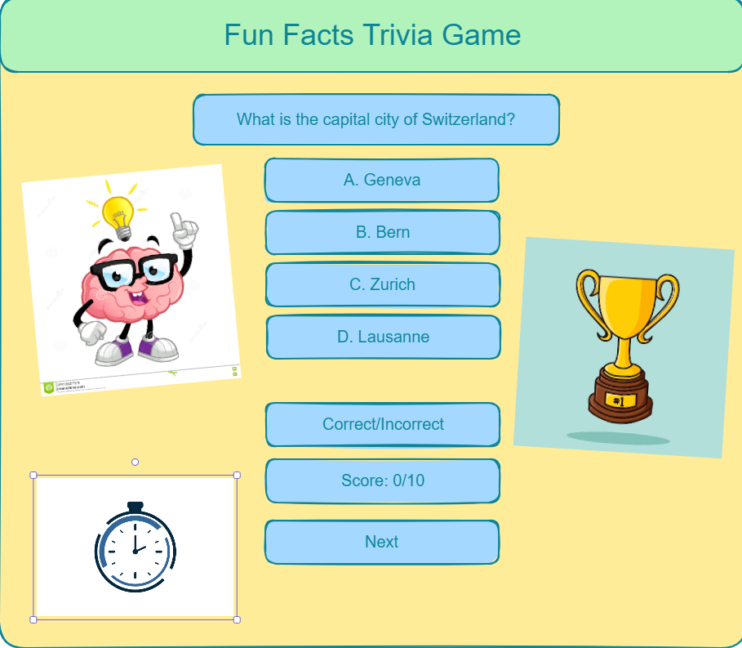
Fun Facts Trivia Game
Project Member: Jeton Aliu
This game serves as an engagement for children, teenagers, and even adults who want to challenge themselves and explore with trivia games. It as a great tool to grow knowledge in various categories while at the same time keeping your mind healthy and engaged. On the right is a demo of how the game is designed; displaying the design, question, answers, score, and 10 second timer for each question. These go along with each page after hitting the “Next” button.

